Slide 1

SOFTWARE QUALITY ENGINEERING
BS Software Engineering
Semester, Fall 2025
Credit Hours 2-1
Instructor: Naseer Jan
Department of Creative Technologies
Air University
Islamabad, Pakistan

Slide 2
Agenda
Week 1 Review
If statement, Switch and loops
Subtopics
  Break statement

Slide 3
Overview
Computers and software systems become pervasive in modern society.
Worldwide users rely on global online infrastructure to fulfill their needs for information processing, storage, search, and retrieval. All these needs are met with the support of the underlying software.
This reliance requires the software to function correctly over a long time, to be easy to use, and so on.
In general, such requirements for high quality need to be satisfied by the people involved in the development and support of these software systems through various quality assurance activities, and the claims for high quality need to be supported by evidence based on concrete measurements and analyses.

Slide 4

Quality Expectation
The software systems must do what they are supposed to do. In other words, they must do the right things.
  the software be the “right software”, or perform the right functions.
  For example, an airline reservation system is supposed to handle reservations, not intended to fly airplanes automatically.
  The focus of the related activities is to validate the required software functions under their intended operational environment.
They must perform these specific tasks correctly or satisfactorily. In other words, they must do the things right.
  the software systems perform their intended functions without problems.
  the system should help travel agents or individual travelers make valid reservations within a pre-specified time limit, instead of making invalid ones, taking too long to make a reservation, or refusing to make reservations without proper justification.
  The focus of the related activities is to verify that the implemented software functions operate as specified

Slide 5
Quality Expectation
the tasks for software quality assurance and quality engineering are to ensure software quality through the related validation and verification activities.
These activities need to be carried out by the people and organizations responsible for developing and supporting these software systems in an overall quality engineering process that inc1udes:
  quality planning
  execution of selected quality assurance or software validation and verification activities
  measurement and analysis to provide convincing evidence to demonstrate software
  quality to all parties involved

Slide 6
Quality Expectation
the negative impact of software problems is also increasing, accompanying the pervasive use of and reliance on software systems in modern society.
The problems could be associated with performing wrong functions, or performing intended functions incorrectly, thus causing unintended consequences.
We would like to see such negative impact be eliminated, if possible. However, due to the increasing demand for automation, additional functionality and convenience by modern society to the computer and software systems, and due to the ubiquitous nature of modern computer, software, and information infrastructure, the size and complexity of modern software systems have also increased steadily.
This increase in size and complexity also has unintended consequences in terms of causing quality problems.

Slide 7
Quality Problems in Large Software System
Many software systems nowadays are highly complex and contain millions of lines of source code. Examples are Microsoft Windows and UNIX operations systems, database products, aviation and in-flight entertainment software, various command communication/control (CCC) systems, etc.
  Developers: hundreds or even thousands of people in their development
  Project life: months or even years
  Operation/application domain: diverse, and sometimes unanticipated, application environments
One may argue that some systems are unnecessarily large and complex.
According to (Wirth, 1995), such “fat software” may be caused by
  indiscriminately adding non-essential features
  poor design
  improper choices of languages and methodologies
which could be addressed by disciplined methodologies and return to essentials for “lean software”.
Various QA techniques can help produce high-quality, lean software.

Slide 8
Testing, Quality Assurance and Quality Engineering
The above factors discussed so far make it virtually impossible or practically infeasible to achieve the complete prevention or elimination of software problems and related negative impact.
Consequently, various software QA activities are carried out
  to prevent or eliminate certain classes of problems that lead to such negative impact, or
  to reduce the likelihood or severity of such negative impact when it is unavoidable.
Software testing plays a central role among the software QA activities. By running the software system or executing its prescribed functions, testers can determine if the observed system behavior conforms to its specifications or requirements.
If discrepancies exist between the two, follow-up actions can be carried out to locate and remove the related problems in software code, which may also include modifying the software design.
Therefore, the detection and removal of defects through testing help reduce the number of defects in delivered software products, thus helping to achieve the quality goals.
testing is the most frequently used means to assure and to demonstrate software quality.

Slide 9
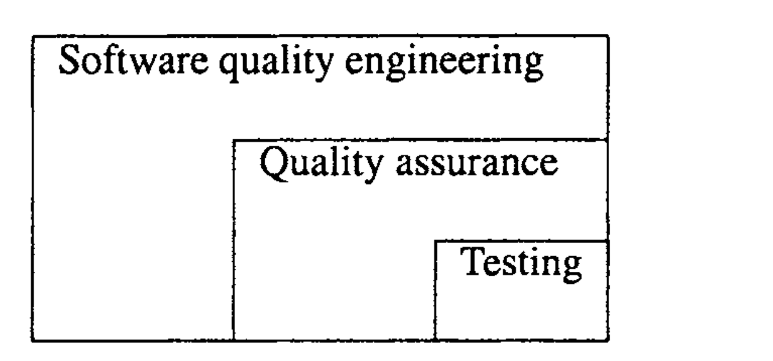
Testing, Quality Assurance and Quality Engineering
there are many other QA alternatives supported by related techniques and activities, such as inspection, formal verification, defect prevention, and fault tolerance.
Inspection is a critical examination of software code or other artifacts by human inspectors to identify and remove problems directly, without resorting to execution.
Fault tolerance prevents global system failures even if local problems exist, through various redundancies strategically designed and implemented into the software systems.
Other QA techniques employ specific means to assure software quality.

Slide 10
Testing, Quality Assurance and Quality Engineering
In addition, all these QA activities need to be managed in an engineering process we
call the software quality engineering process, with quality goals set early in the product
development, and strategies for QA selected, carried out, and monitored to achieve these preset quality goals.
As part of this overall process, data collected during the QA activities, as well as from the overall development activities, can be analyzed to provide feedback to the software development process for decision making, project management, and quantifiable quality improvement.

Slide 11
Questions
Questions and Answers sessions

Slide 12


